Slide 1

4. Differential Expression Analysis
Jose Alejandro Romero Herrera
Data Scientist

Slide 2
Agenda
RNAseq
Data correction and normalization
Correlation between samples
Differential Expression Analysis
Comparison between conditions
Gene-gene correlation Networks
GO term
Functional analysis

Slide 3
Differential Expression Analysis (DEA)
Ultimate goal of RNAseq is to compare expression between conditions
Calculation of Log₂ Fold Changes (LFC) and their statistical significance
Fold change: ratio or subtraction of mean expression levels between conditions
P-value: probability of observing the fold change if it was due by chance
Filter significant DE between conditions
Absolute LFC > 1 ( >1 or < -1), adjusted p-value < 0.05
Visualization with volcano plots, heatmaps and MA plots
$$LFC=\log_{2}\left(\frac{\begin{aligned}Average Expression of Gene A \\ in condition 2\end{aligned}}{\begin{aligned}Average Expression of Gene A \\ in condition 1\end{aligned}}\right)$$

Slide 4
Agenda
2
3
Three factors, with nesting
Conclusions
One factor, two levels
1
One factor, three levels
Two factors, with interaction
4
5

Slide 5
One factor, two levels
Design → Effect of Treatment
Des = ~ 1 + condition
Expression = Intercept + Effect of Condition
Exp = 𝛽₀ + 𝛽₁ CondTreat
Condition
Samples | Condition <factor>
Control1 | Control
Control2 | Control
Control3 | Control
Treatment1 | Treatment
Treatment2 | Treatment
Treatment3 | Treatment
Model/Contrast matrix
Control
Treated
Samples | Intercept | Condition
Control1 | 1 | 0
Control2 | 1 | 0
Control3 | 1 | 0
Treatment1 | 1 | 1
Treatment2 | 1 | 1
Treatment3 | 1 | 1
One hot coding
Coefficients from DESeq:
𝛽₀ = Intercept
𝛽₁ = cond_Treat_vs_Control
𝛽₁
Expression
𝛽₀
Null hypothesis: 𝛽₁ = 0
Control
Treat

Slide 6
One factor, two levels
Design → Effect of Treatment
Des = ~ 0 + condition
Exp = 𝛽₀Control + 𝛽₁ Treat
Condition
Samples | Condition <factor>
Control1 | Control
Control2 | Control
Control3 | Control
Treatment1 | Treatment
Treatment2 | Treatment
Treatment3 | Treatment
Model/Contrast matrix
Control
Treated
Samples | Condition Control | Condition Treat
Control1 | 1 | 0
Control2 | 1 | 0
Control3 | 1 | 0
Treatment1 | 0 | 1
Treatment2 | 0 | 1
Treatment3 | 0 | 1
One hot coding
Null hypothesis:
𝛽₁ - 𝛽₀ = 0
𝛽₁
Expression
𝛽₀
Control
Treat

Slide 7
One factor, three levels
Design : ~ 1 + condition
Exp = 𝛽₀ + 𝛽₁CondTreat1 + 𝛽₂CondTreat2
Condition
Samples | Condition <factor>
Control1 | Control
Control2 | Control
Control3 | Control
Treat1_1 | Treat1
Treat1_2 | Treat1
Treat1_3 | Treat1
Treat2_1 | Treat2
Treat2_2 | Treat2
Treat2_3 | Treat2
Control
Treat1
Treat2
Model/Contrast matrix
Coefficients from DESeq:
𝛽₀ = Intercept
𝛽₁ = cond_Treat1_vs_Control
𝛽₂ = cond_Treat2_vs_Control
Samples | Intercept | CondTreat1 | CondTreat2
Control1 | 1 | 0 | 0
Control2 | 1 | 0 | 0
Control3 | 1 | 0 | 0
Treat1_1 | 1 | 1 | 0
Treat1_2 | 1 | 1 | 0
Treat1_3 | 1 | 1 | 0
Treat2_1 | 1 | 0 | 1
Treat2_2 | 1 | 0 | 1
Treat2_3 | 1 | 0 | 1
One hot coding
Null hypothesis:
Treat1 vs Control: 𝛽₁ = 0
Treat2 vs Control: 𝛽₂ = 0
Treat2 vs Treat1: 𝛽₁ - 𝛽₂ = 0
𝛽₁
Expression
𝛽₂
𝛽₀

Slide 8
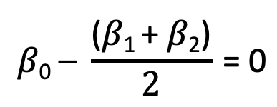
One factor, three levels
What if we wanted to compare the effect of any treatment vs control?
Design is the same: ~ 1 + condition
We should not combine treatments
together!
They are not replicates
Inflated/deflated estimates
Null hypothesis for Treats vs Control:
Condition
Model/Contrast matrix
Samples | Intercept | CondTreat
Control1 | 1 | 0
Control2 | 1 | 0
Control3 | 1 | 0
Treat1_1 | 1 | 1
Treat1_2 | 1 | 1
Treat1_3 | 1 | 1
Treat2_1 | 1 | 1
Treat2_2 | 1 | 1
Treat2_3 | 1 | 1
Control
Treat1
Treat2
Control
Treat
Treat
𝛽₁
$$\text{β}\text{0}\text{ –} \frac{\text{(}\text{β}\text{1 }\text{+ }\text{β}\text{2}\text{)}}{2} \text{= 0}$$
Expression
𝛽₂
𝛽₀

Slide 9
Two factors, with interaction
Control
Treat
Design :
~ 1 + genotype + condition + genotype: condition
Condition
Coefficients from DESeq:
𝛽₀ = Intercept
𝛽₁ = genotype_GenB_vs_GenA
𝛽₂ = condition_Treat_vs_Control
𝛽₃ = genotypeGenB.conditionTreat
Genotype
A
B
Samples | Intercept | CondTreat1 | GenB
Control1_A | 1 | 0 | 0
Control2_A | 1 | 0 | 0
Control3_A | 1 | 0 | 0
Control1_B | 1 | 1 | 1
Control1_B | 1 | 1 | 1
Control1_B | 1 | 1 | 1
Treat1_A | 1 | 1 | 0
Treat2_A | 1 | 1 | 0
… | … | … | …
𝛽₃
Expression
Null hypothesis:
Gen B vs Gen A (Control): 𝛽₁ = 0
Gen B vs Gen A (Treat): 𝛽₁ + 𝛽₃ = 0
Treat vs Control (Gen A): 𝛽₂ = 0
Treat vs Control (Gen B): 𝛽₂ + 𝛽₃ = 0
Interaction: 𝛽₃ = 0
𝛽₁
𝛽₂
Model/Contrast matrix
𝛽₀

Slide 10
Three factors, with nesting
Control
Treat
We see that Patient is “nested” in Genotype
Patient should not be included in the design!
Including Patient into the design might over- or underestimate errors!
We need to adjust for the nested factor:
Increased Type I errors
Loss of power
Condition
Genotype
A
B
C
D
Design :
~ 1 + genotype + condition + genotype: condition
Patient
1
2
B
B
Expression
A
A

Slide 11
Conclusions
Using model matrix gives a consistent way to define contrasts of interest
Works for imbalanced and/or nested designs (weights coefficients correctly)
It can be applied in other cases
Similar approach with `R/emmeans` package (for extracting estimated means from linear models)
It works similarly with edgeR and limma packages
However:
Using DESeq coefficients is less verbose
This approach is limited to factors, for continuous predictors it doesn’t really work

Slide 12
Acknowledgements
Hugo Tavares. University of Cambridge. @tavareshugo
Diana Adrejeva. Universtiy of Copenhagen. HeaDS.
Thilde Bagger Terkelsen. Universtiy of Copenhagen. HeaDS.
You! For you attention!

Slide 13
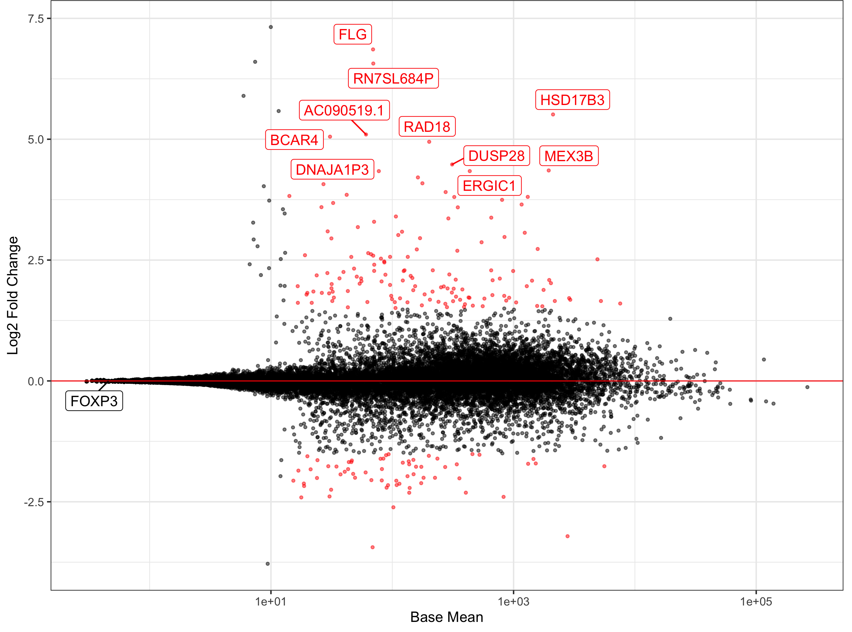
DEA visualization
MA plot
Genes more expressed
in treated cells (LFC > 1)
Volcano plot
Log₂ Fold Change
-Log₁₀(Adjustedp-value)
Base mean
Genes more expressed
in untreated cells (LFC < 1)
Log₂ Fold Change

Slide 14
DEA visualization
Heatmap of expression
Showing UP regulated genes (LFC > 1)
in stimulated vs untreated cells

Slide 15
Gene-gene correlation analysis
Identify clusters of genes correlating with each other in a condition
Replicates and conditions are compared
Clusters can be used for GO term and pathway
analysis
Tools: DGCA
https://doi.org/10.1186/s12918-016-0349-1

Slide 16
Gene-gene network analysis
Gene correlations can be used to construct networks for differential changes between conditions
Network can be as well divided in subsets
Network tool: Cytoscape
Annotation for network: String
https://doi.org/10.1186/s12918-016-0349-1
Notes:
Cytoscape: https://cytoscape.org/

Slide 17
GO term and pathway analysis
GO term
Formal representation of a body of knowledge in the biological domain
Genes are annotated to different sets of knowledge
Biological processes: DNA repair, signal transduction, etc.
Molecular function: catalysis, transportation, etc.
Cellular component: ribosome, nucleus, etc.
Pathways
Set of genes connected to each other in a specific biological function
KEGG pathway database
Metabolism
Genetic information processing
Environmental Information Processing
Cellular processes
Organismal Systems
Human Diseases
Notes:
Gene ontology webpage: http://geneontology.org/
KEGG pathway database webpage: https://www.genome.jp/kegg/pathway.html

Slide 18
Enrichment Analysis
Definition
Identify classes of genes that are over-represented in a large set of genes, and may have an association with a body of knowledge
Returns scores or p-values
Different ways:
SEA
GSEA
MEA
https://doi.org/10.1016/j.coisb.2019.04.002
Notes:
Read more! https://www.sciencedirect.com/science/article/pii/B9780128096338204044

Slide 19
Tools
PANTHER, DAVID, GOrilla, Ontologizer
Notes:
Gene ontology tools
GOrilla: http://cbl-gorilla.cs.technion.ac.il/
PANTHER: http://www.pantherdb.org/
Ontologizer: http://ontologizer.de/
KEGG pathway analysis:
DAVID: https://david.ncifcrf.gov/

Slide 20

Workflow
Experimental design
Create gene count matrix
Normalization
 | Unt 1 | Unt 1 | Treat 2 | Treat 2
Gene A | 123 | 150 | 143 | 130
Gene B | 18 | 10 | 233 | 209
DESeq
 | Unt 1 | Unt 1 | Treat 2 | Treat 2
Gene A | 13.8 | 14.2 | 12.4 | 14.6
Gene B | 1.9 | 1.25 | 24.1 | 20.9
Untreated
Treated
Sample comparison
GO term and pathway analysis
DE analysis
DESeq
GOrilla,
DAVID,
PANTHER
Distance heatmap and PCA
MA plots, Volcano plots or Heatmaps
Network analysis
Gene-gene correlation analysis
Cytoscape
DGCA

